Slide 1
What is cloud Computing

Slide 2
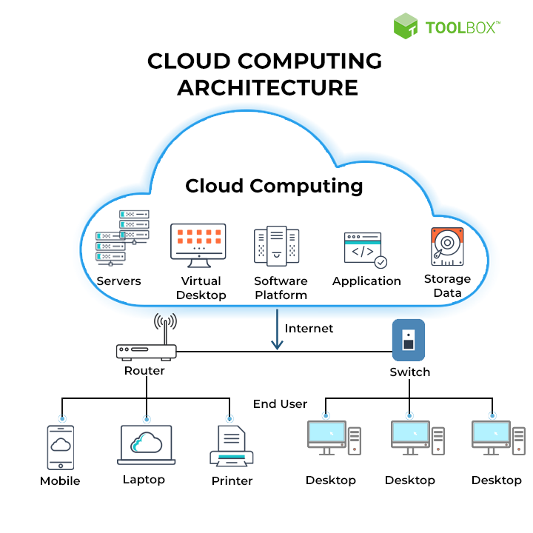

Slide 3
Organizations of every type, size, and industry are using the cloud for a wide variety of use cases, such as data backup, disaster recovery, email, virtual desktops, software development and testing, big data analytics, and customer-facing web applications. For example, healthcare companies are using the cloud to develop more personalized treatments for patients.
Financial services companies are using the cloud to power real-time fraud detection and prevention.
And video game makers are using the cloud to deliver online games to millions of players around the world.

Slide 4
Benefits of cloud computing

Slide 5


Agility
The cloud gives you easy access to a broad range of technologies so that you can innovate faster and build nearly anything that you can imagine. You can quickly spin up resources as you need them–from infrastructure services, such as compute, storage, and databases, to Internet of Things, machine learning, data lakes and analytics, and much more.
You can deploy technology services in a matter of minutes, and get from idea to implementation several orders of magnitude faster than before. This gives you the freedom to experiment, test new ideas to differentiate customer experiences, and transform your business.
Elasticity
With cloud computing, you don’t have to over-provision resources up front to handle peak levels of business activity in the future. Instead, you provision the amount of resources that you actually need. You can scale these resources up or down to instantly grow and shrink capacity as your business needs change.
Cost savings
The cloud allows you to trade fixed expenses (such as data centers and physical servers) for variable expenses, and only pay for IT as you consume it. Plus, the variable expenses are much lower than what you would pay to do it yourself because of the economies of scale.
Deploy globally in minutes
With the cloud, you can expand to new geographic regions and deploy globally in minutes. For example, AWS has infrastructure all over the world, so you can deploy your application in multiple physical locations with just a few clicks. Putting applications in closer proximity to end users reduces latency and improves their experience.

Slide 6
Types of cloud computing
The three main types of cloud computing include
Infrastructure as a Service,
Platform as a Service, and
Software as a Service.
Each type of cloud computing provides different levels of control, flexibility, and management so that you can select the right set of services for your needs.

Slide 7
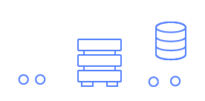
Infrastructure as a Service (IaaS)
IaaS contains the basic building blocks for cloud IT. It typically provides access to networking features, computers (virtual or on dedicated hardware), and data storage space. IaaS gives you the highest level of flexibility and management control over your IT resources. It is most similar to the existing IT resources with which many IT departments and developers are familiar.

Slide 8
Platform as a Service (PaaS)
PaaS removes the need for you to manage underlying infrastructure (usually hardware and operating systems), and allows you to focus on the deployment and management of your applications. This helps you be more efficient as you don’t need to worry about resource procurement, capacity planning, software maintenance, patching, or any of the other undifferentiated heavy lifting involved in running your application.
Software as a Service (SaaS)
SaaS provides you with a complete product that is run and managed by the service provider. In most cases, people referring to SaaS are referring to end-user applications (such as web-based email). With a SaaS offering, you don’t have to think about how the service is maintained or how the underlying infrastructure is managed. You only need to think about how you will use that particular software.

Slide 9
What is AWS ?
Amazon Web Services (AWS) is the world’s most comprehensive and broadly adopted cloud, offering over 200 fully featured services from data centers globally. Millions of customers—including the fastest-growing startups, largest enterprises, and leading government agencies—are using AWS to lower costs, become more agile, and innovate faster.

Slide 10
Most functionality
AWS has significantly more services, and more features within those services, than any other cloud provider–from infrastructure technologies like compute, storage, and databases–to emerging technologies, such as machine learning and artificial intelligence, data lakes and analytics, and Internet of Things. This makes it faster, easier, and more cost effective to move your existing applications to the cloud and build nearly anything you can imagine.
AWS also has the deepest functionality within those services. For example, AWS offers the widest variety of databases that are purpose-built for different types of applications so you can choose the right tool for the job to get the best cost and performance.

Slide 11
What is Azure?
The Azure cloud platform is more than 200 products and cloud services designed to help you bring new solutions to life—to solve today’s challenges and create the future. Build, run and manage applications across multiple clouds, on-premises and at the edge, with the tools and frameworks of your choice.

Slide 12
AWS Vs Azure
Amazon Web Services (AWS) presently dominates infrastructure, including scalable storage, networking, server, mobile development, and cybersecurity solutions. Microsoft Azure, its chief rival, provides some of the most scalable and efficient software solutions. Google Cloud Platform GCP offers high-end big data analytics solutions and allows easy interaction with other vendor products.
Certified cloud computing specialists are in demand, outperforming the disruptive move away from in-house servers and computing capacity toward the flexibility and scalability of cloud-based systems. Explore below how the three can shape your IT career path.
What exactly is cloud computing?
Cloud computing defines the supply of computing services—including servers, storage, databases, networking, software, analytics, and intelligence—via the internet ("the cloud") to provide fast innovation, flexible resources, and economies of scale. Users pay-as-you-go, which helps cut operating expenses, run infrastructure more efficiently, and scale as business needs change.

